Slide 1
EDES 301 Smart Curtains Proposal
10/06/2024
Emma Kirchhoff

Slide 2
Background Information
What is being proposed?
Natural alarm clock that opens curtains in response to sunlight
Better for your body to wake up in response to sunlight than noisy alarm
Device that can trigger mechanism to open curtains in response to sunlight
Other programmable settings/component options: switch to power off device (prevent any open/close of curtains), button to open/close curtains at will, curtains close automatically when dark, delayed opening feature using potentiometer(?) (wait x minutes after sensing sunlight to open curtains)
Similar to existing projects:
https://www.instructables.com/Alexa-Curtain-Control-System-3D-Printable-and-Low-/
https://www.instructables.com/Automatic-Curtain-With-Arduino/
For the scope of this class, a scaled-down prototype with functional code and electrical components (but less fidelity in the mechanical aspect) will be most appropriate
Improvement/addition to current project: Light sensor triggers curtain-opening mechanism once threshold is reached (rather than programming via timer or controlling with phone)

Slide 3
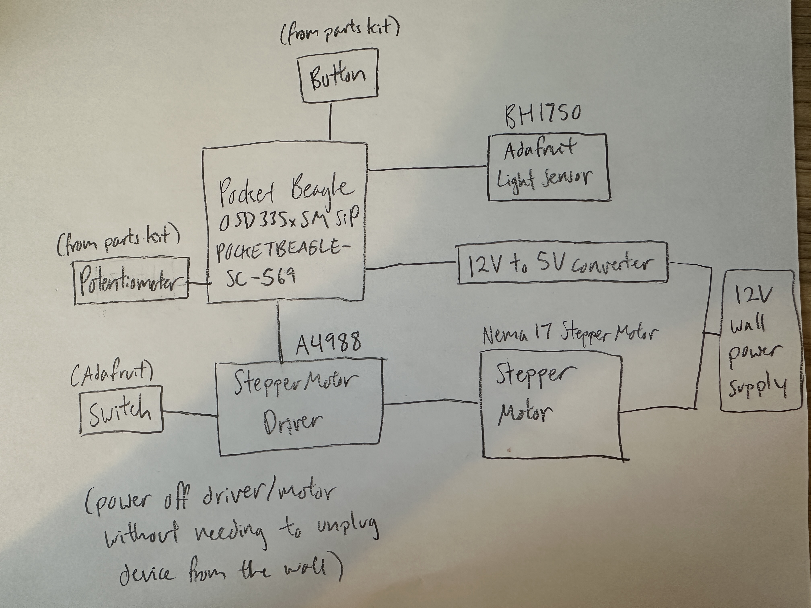
System Block Diagram

Slide 4
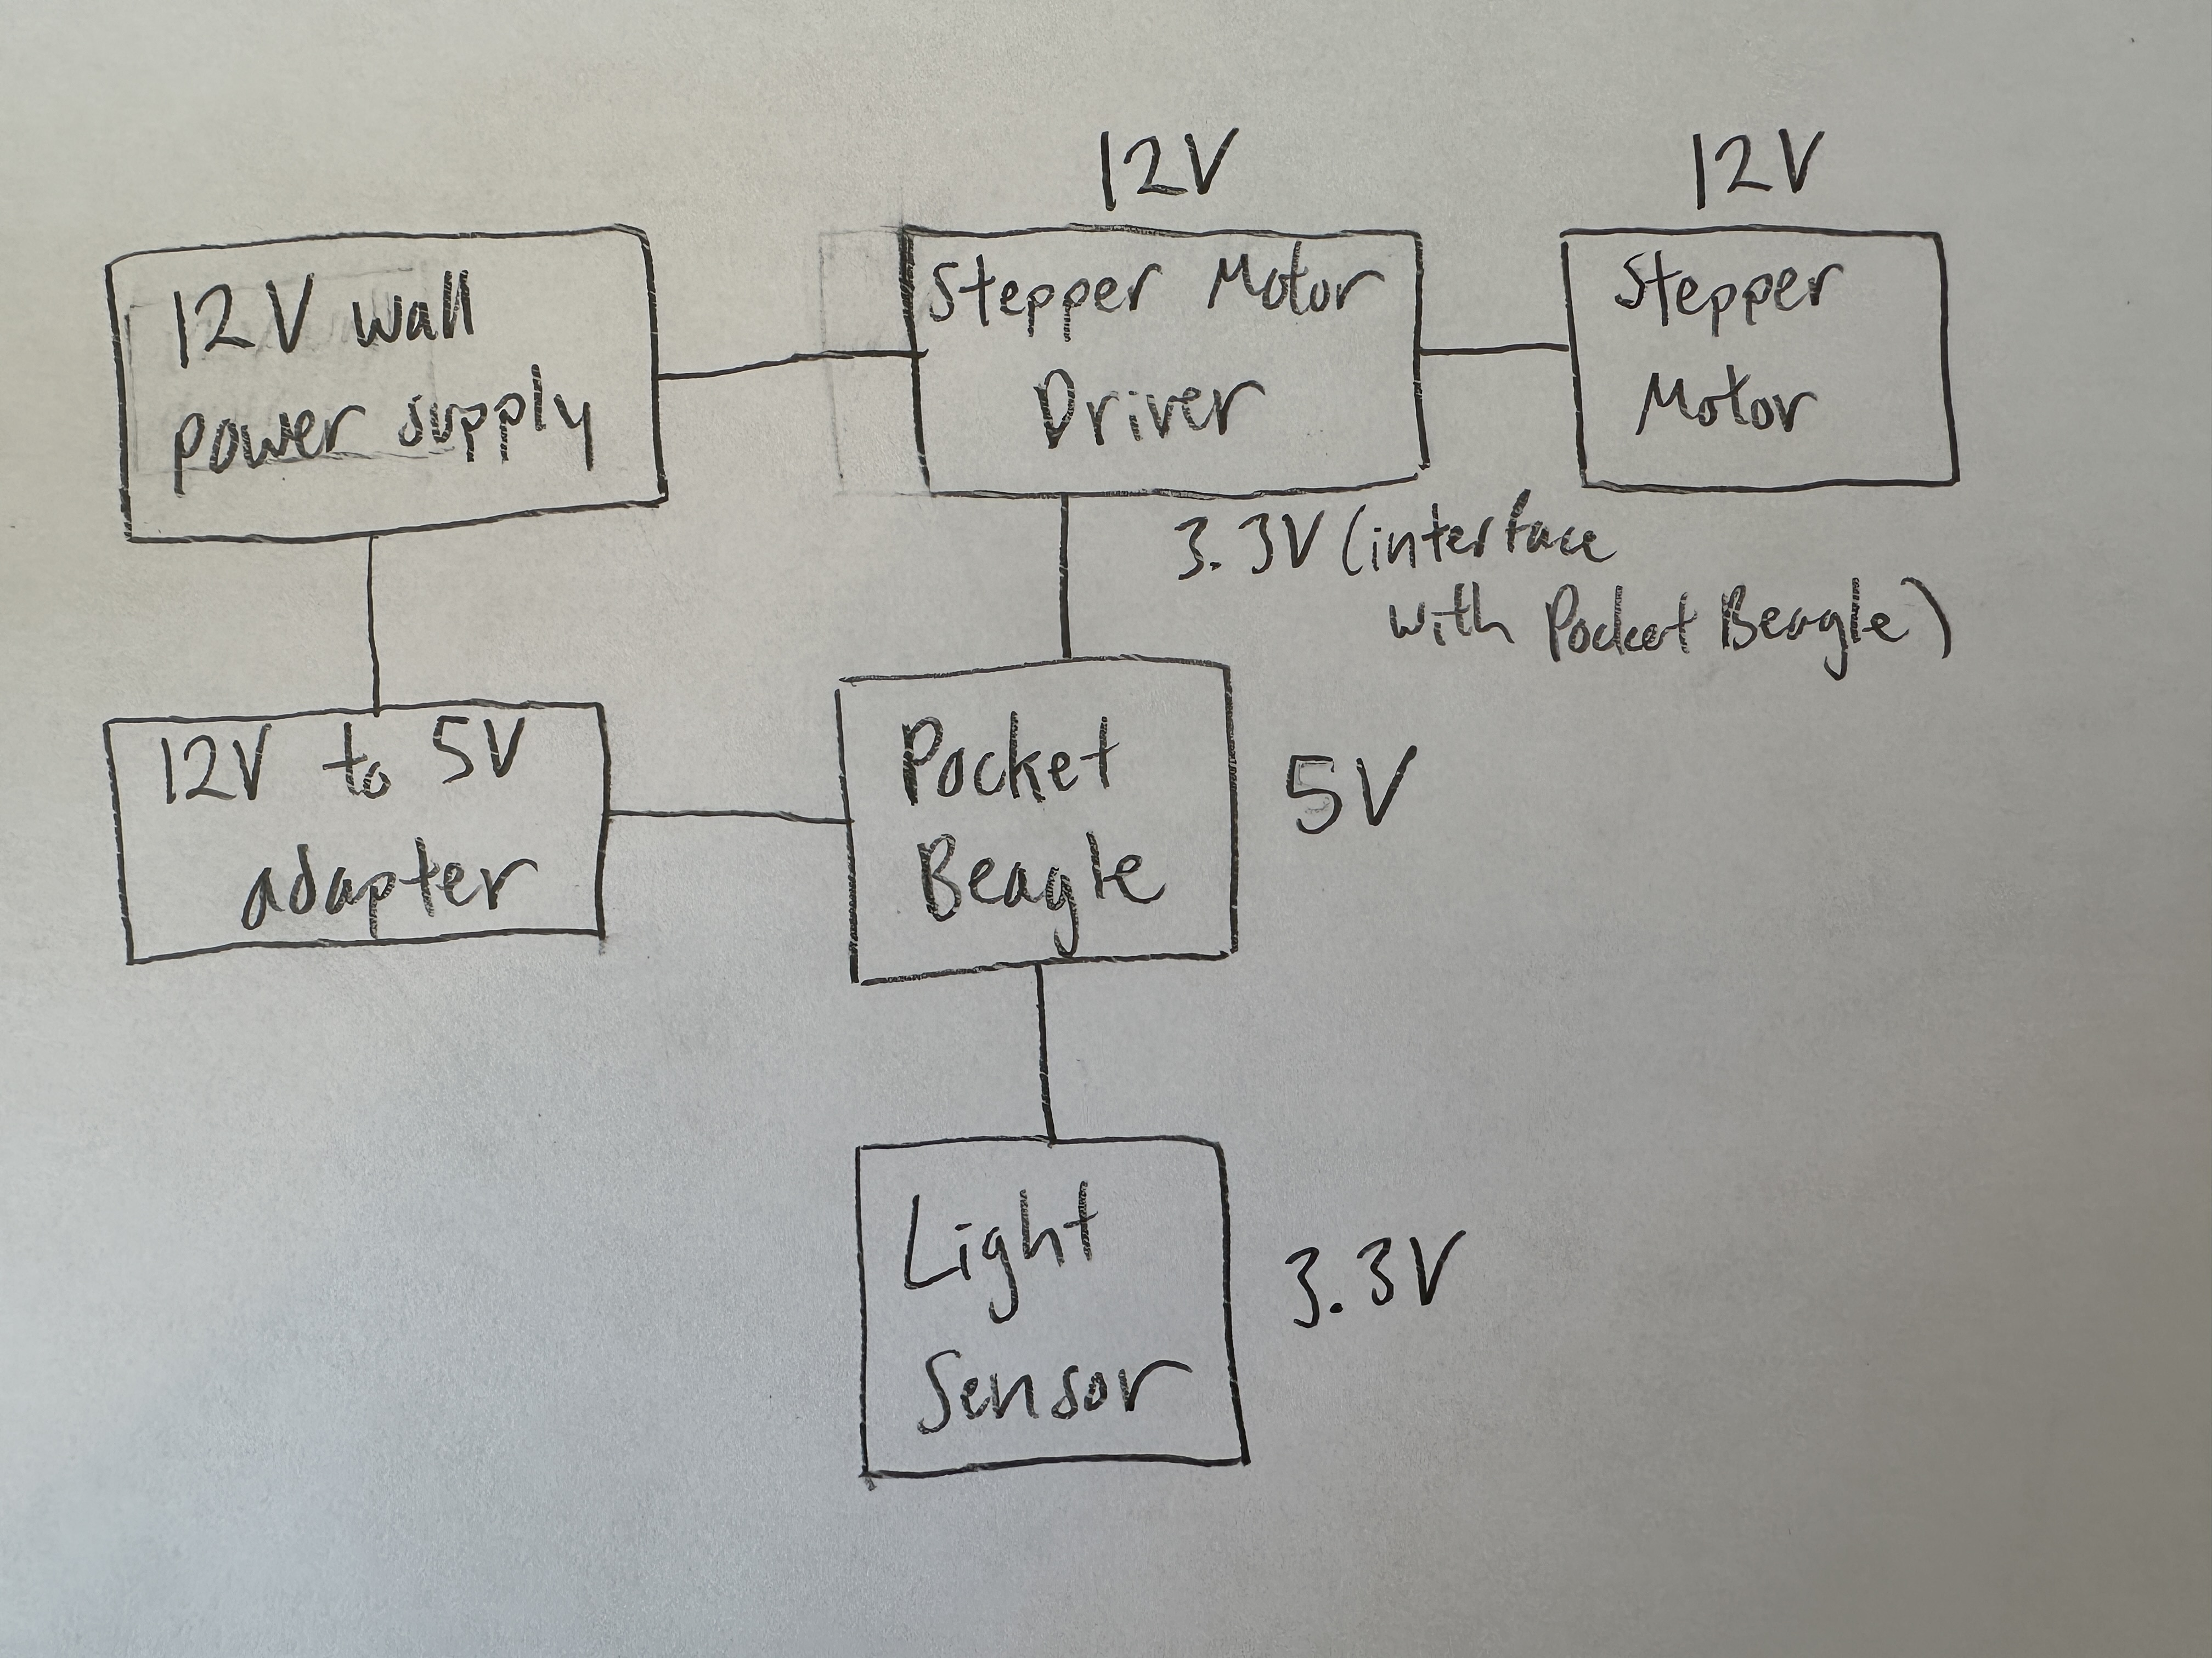
Power Block Diagram

Slide 5
Components / Budget
Component | EDES301 to Buy? | Cost
Stepper motor driver (from parts list) | yes | $2.04
Stepper motor (from parts list) | yes | $7.99
Light sensor (from parts list) | yes | $4.50
Braided Fishing Wire* (amazon, can substitute with a cheaper option) | no | $13.88
12V – 5V adapter (from parts list) | yes | $8.89
Slide Switch (do not need to buy if we have this/similar at the OEDK) | maybe | $0.95
+ PocketBeagle, jumper cables, breadboard, general circuit components from parts kit (free)
*Fishing wire may not be necessary if I am making a scaled down prototype rather than moving real curtains – it may be best to use components from the OEDK to make the mechanical portion of the project, and the OEDK may already have something similar – I will check, and buy only if needed
Total Cost: $24.37 ($37.30 with fishing wire)

Slide 6
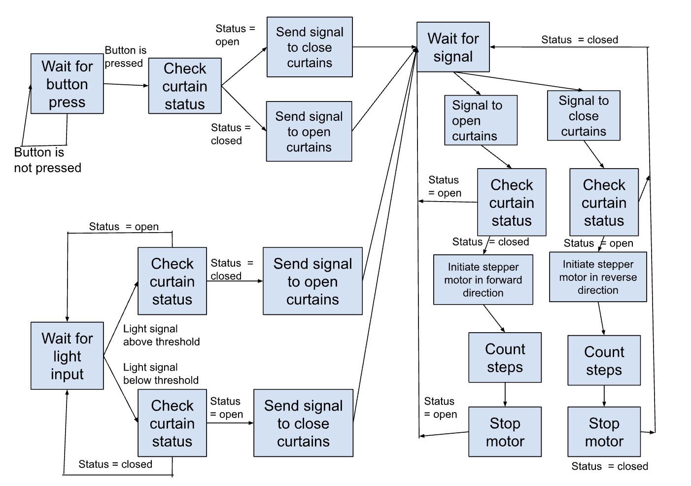
Software Flow Diagram

